Slide 1

THERMODYNAMICS I (ME 265)
FIRST LAW OF THERMODYNAMICS
Francis Kofi Forson (Professor)
Department of Mechanical Engineering
Kwame Nkrumah University of Science and Technology, Kumasi, Ghana

Slide 2
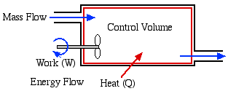
First Law of Thermodynamics: Open system
An open system (control volume) differs from a closed system in that it involves mass flow. Mass carries energy with it, and thus the mass and energy content of a system change when mass enters or leaves.

Slide 3
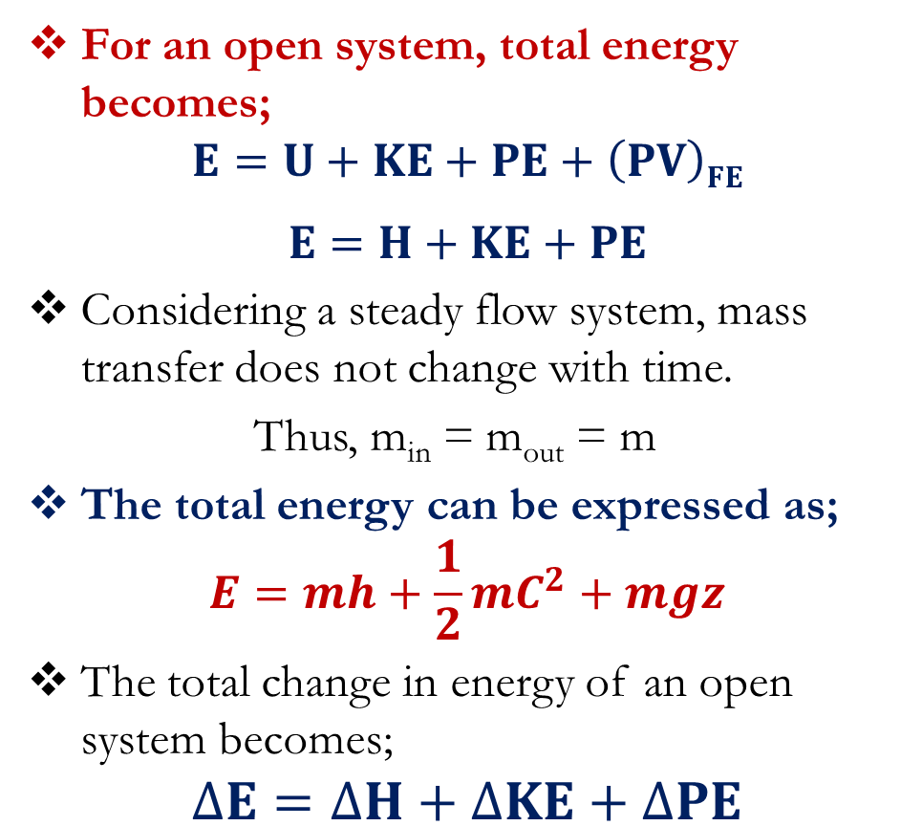
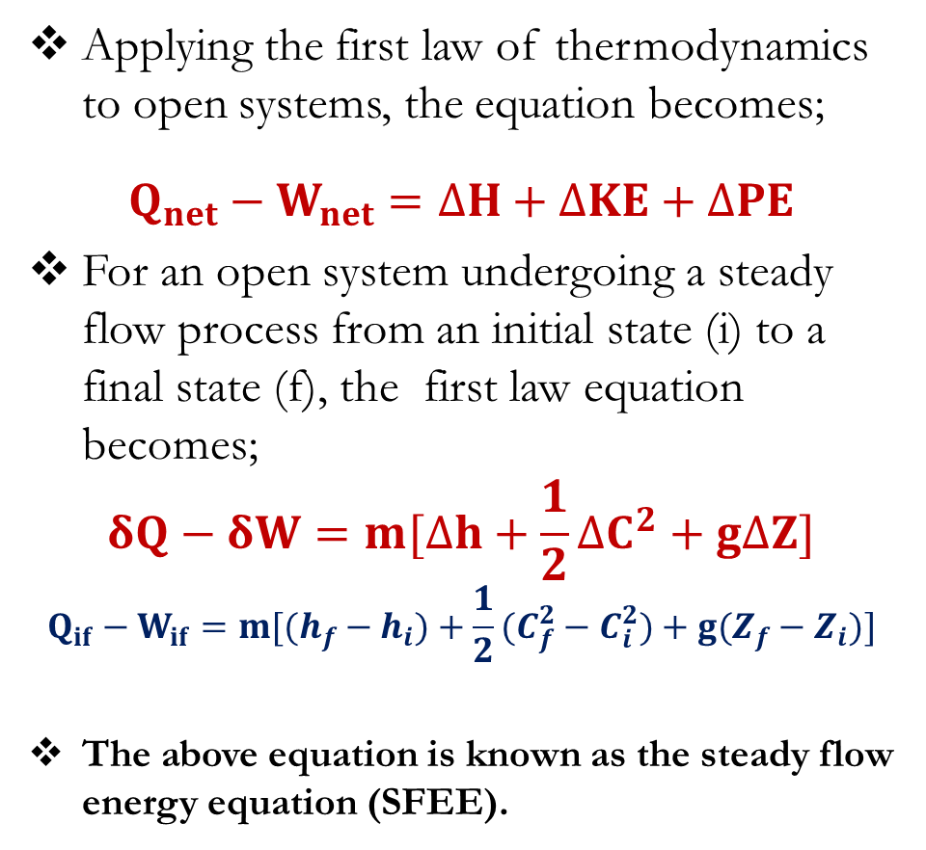
First Law of Thermodynamics: Open system
For an open system, total energy becomes;
$$E=U+KE+PE+\left(PV\right)FE$$
$$E=H+KE+PE$$
Considering a steady flow system, mass transfer does not change with time.
Thus, m_{in} = m_{out} = m
The total energy can be expressed as;
$$E=mh+\frac{1}{2}mC^{2}+mgz$$
The total change in energy of an open system becomes;
$$∆E=∆H+∆KE+∆PE$$
Applying the first law of thermodynamics to open systems, the equation becomes;
$$Q_{net}−W_{net}=∆H+∆KE+∆PE$$
For an open system undergoing a steady flow process from an initial state (i) to a final state (f), the first law equation becomes;
$$δQ−δW=m[∆h+\frac{1}{2}∆C^{2}+g∆Z]$$
$$Q_{if}−W_{if}=m[(h_{f}−h_{i})+\frac{1}{2}(C_{f}^{2}−C_{i}^{2})+g(Z_{f}−Z_{i})]$$
The above equation is known as the steady flow energy equation (SFEE).

Slide 4
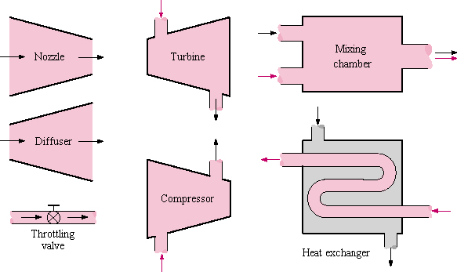
First Law of Thermodynamics: Open system
Most engineering devices such as turbines, compressors and nozzles operate for long periods of time under the same conditions, and they are classified as steady-flow devices.

Slide 5
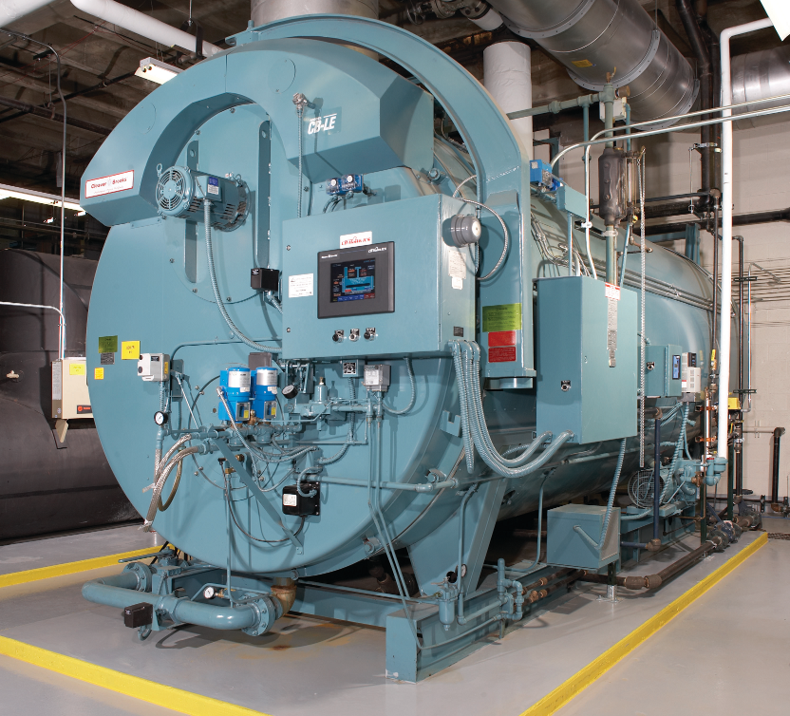
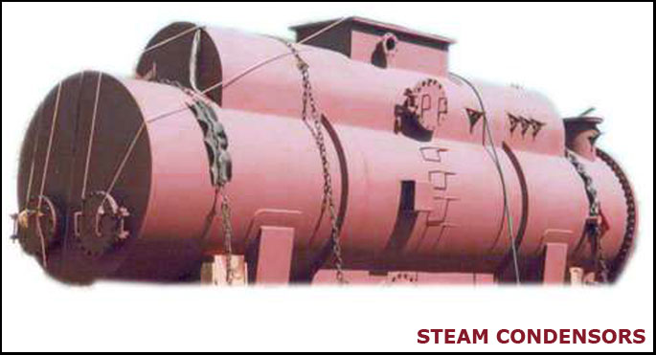
Applications of steady flow energy equation
Boilers and Condensers
In a boiler operating under steady conditions, water is pumped into the boiler along the feed line at the same rate at which steam leaves the boiler along the steam main, and heat energy is supplied from the furnace at steady rate.
In principle, a condenser is a boiler in reverse. Heat energy is removed in order to condense the vapour into a liquid.
If the condenser is in steady state, then the amount of liquid (condensate) must be equal to the amount of vapour entering the condenser.

Slide 6
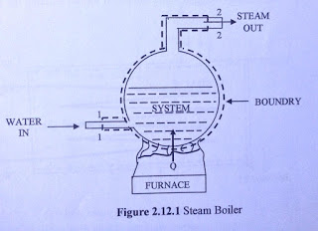
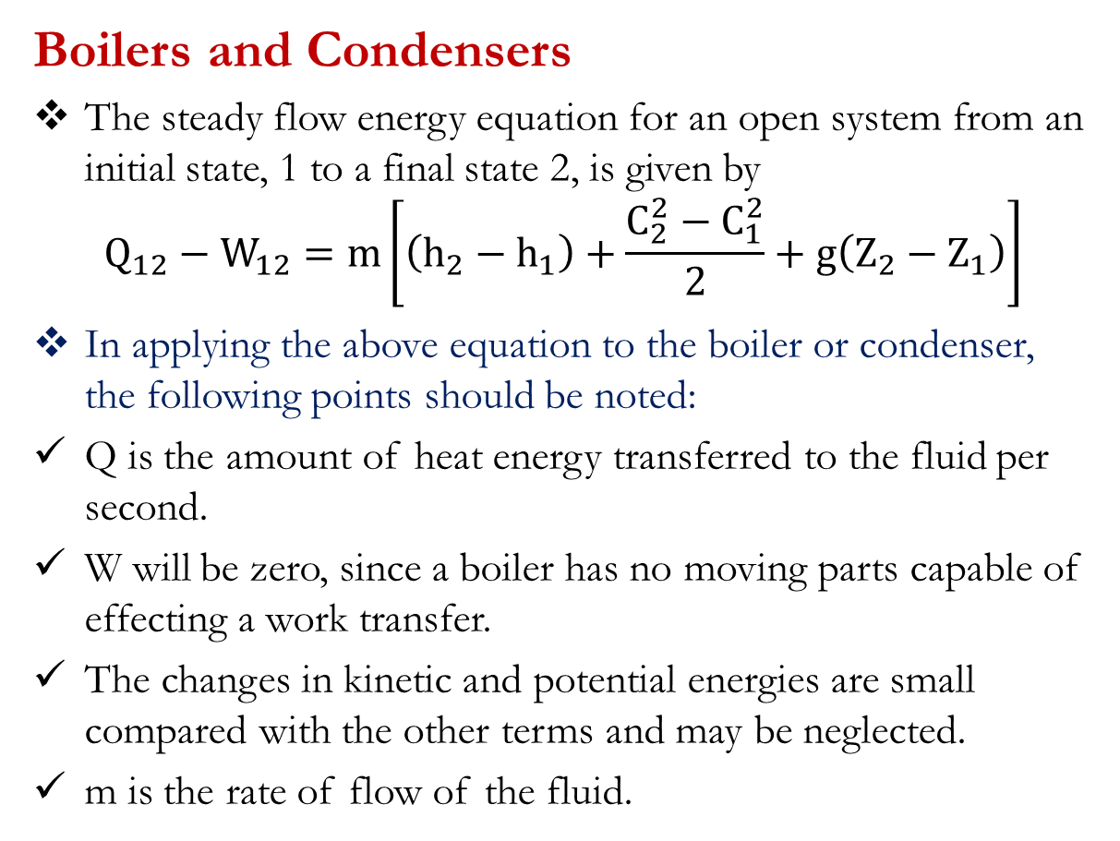
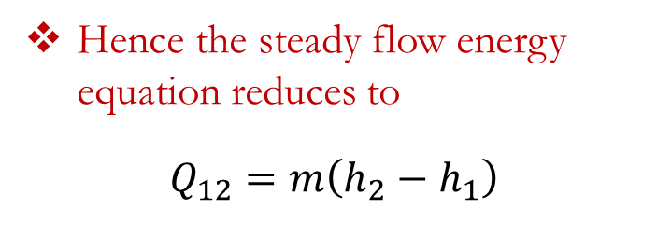
Applications of steady flow energy equation
Boilers and Condensers
The steady flow energy equation for an open system from an initial state, 1 to a final state 2, is given by
$$Q_{12}−W_{12}=m\left[\left(h_{2}−h_{1}\right)+\frac{C_{2}^{2}−C_{1}^{2}}{2}+g\left(Z_{2}−Z_{1}\right)\right]$$
In applying the above equation to the boiler or condenser, the following points should be noted:
Q is the amount of heat energy transferred to the fluid per second.
W will be zero, since a boiler has no moving parts capable of effecting a work transfer.
The changes in kinetic and potential energies are small compared with the other terms and may be neglected.
m is the rate of flow of the fluid.
Hence the steady flow energy equation reduces to
$$Q_{12}=m\left(h_{2}−h_{1}\right)$$

Slide 7
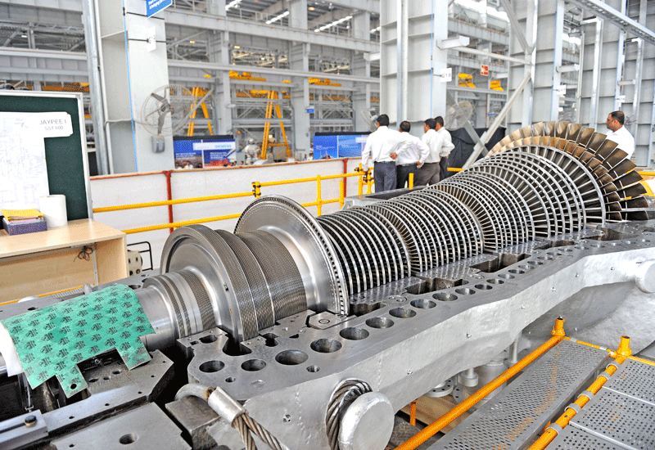
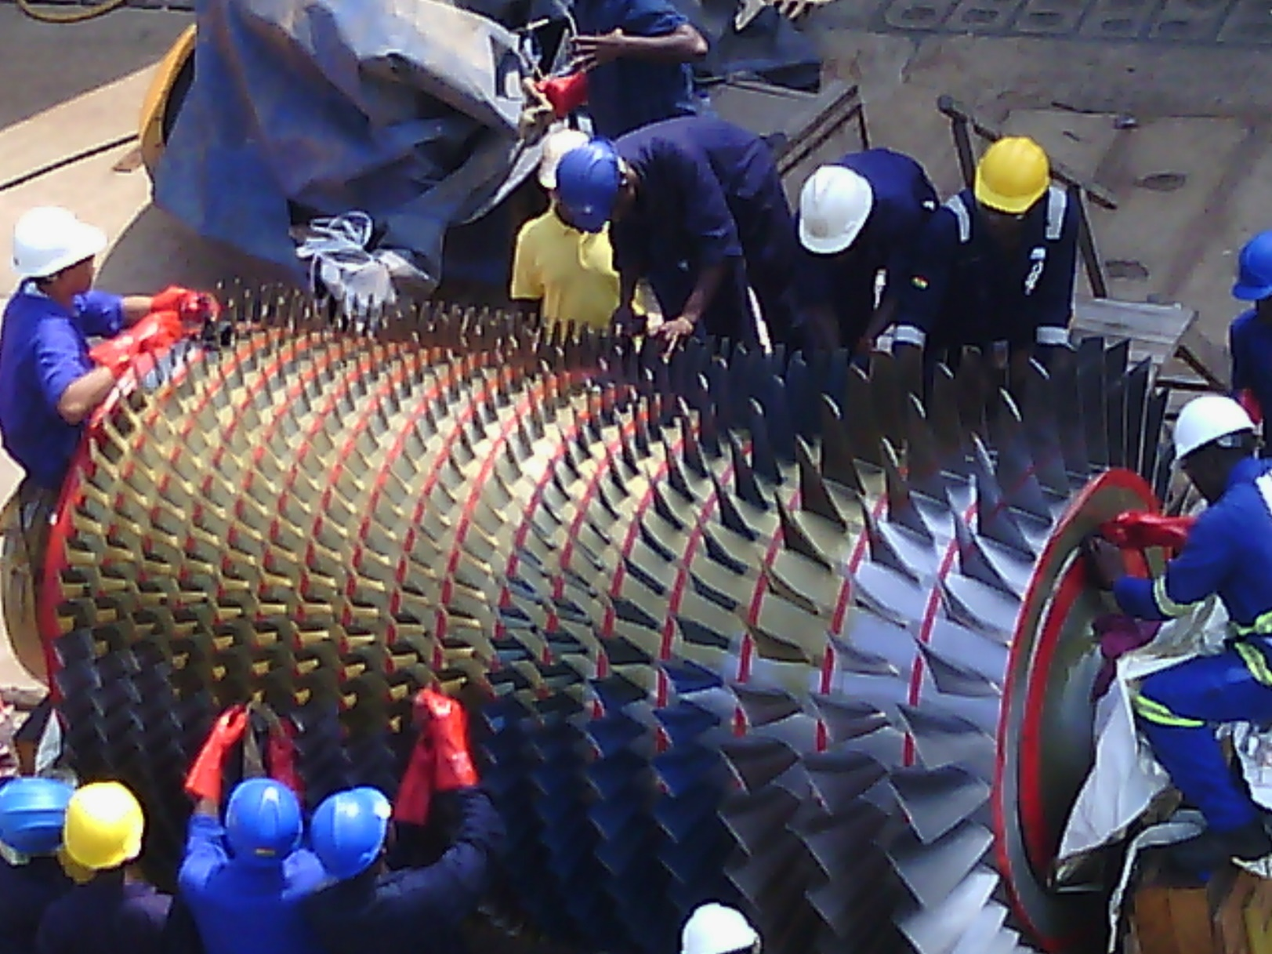
Applications of steady flow energy equation
Turbines and Compressors
A turbine is a device which uses a pressure drop to produce work energy which is used to drive an external load.
The action of a compressor is the reverse of a turbine. It uses external work energy to produce a pressure rise.

Slide 8
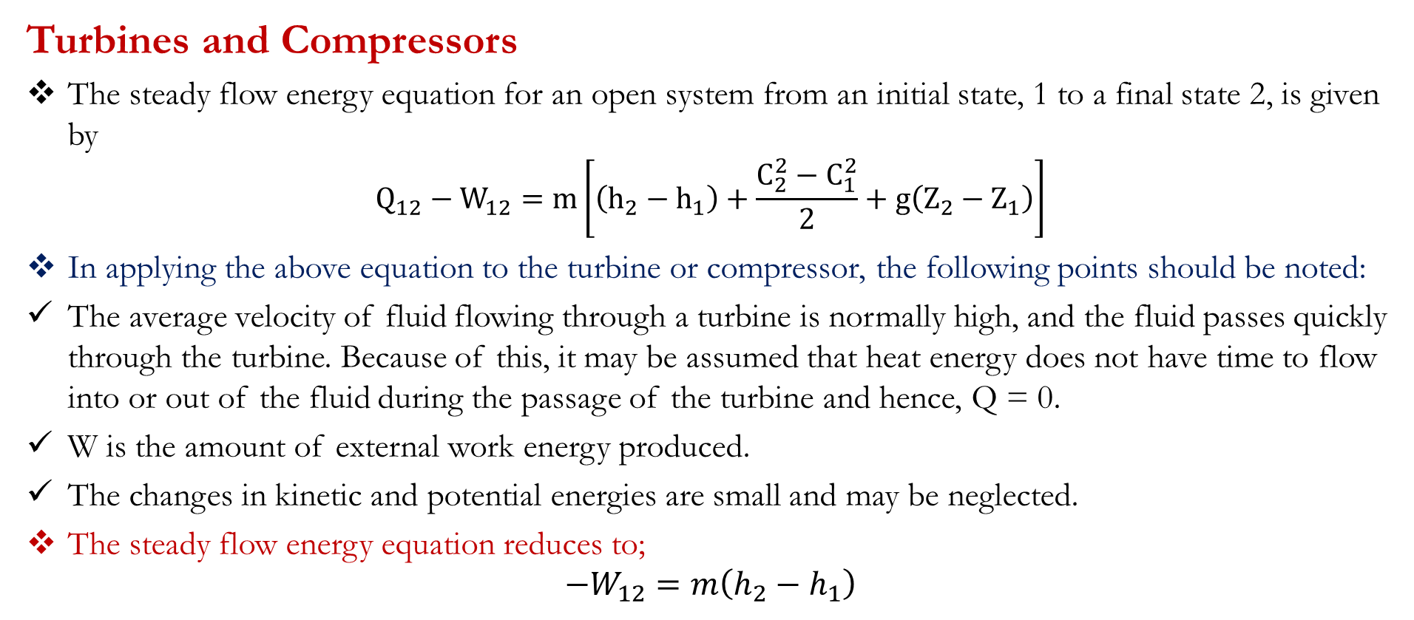
Applications of steady flow energy equation
Turbines and Compressors
The steady flow energy equation for an open system from an initial state, 1 to a final state 2, is given by
$$Q_{12}−W_{12}=m\left[\left(h_{2}−h_{1}\right)+\frac{C_{2}^{2}−C_{1}^{2}}{2}+g\left(Z_{2}−Z_{1}\right)\right]$$
In applying the above equation to the turbine or compressor, the following points should be noted:
The average velocity of fluid flowing through a turbine is normally high, and the fluid passes quickly through the turbine. Because of this, it may be assumed that heat energy does not have time to flow into or out of the fluid during the passage of the turbine and hence, Q = 0.
W is the amount of external work energy produced.
The changes in kinetic and potential energies are small and may be neglected.
The steady flow energy equation reduces to;
$$−W_{12}=m\left(h_{2}−h_{1}\right)$$

Slide 9
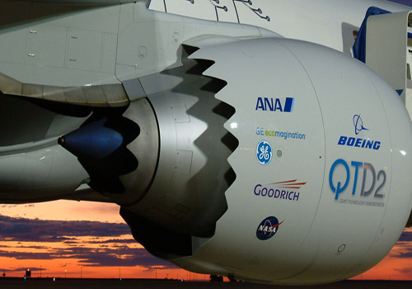
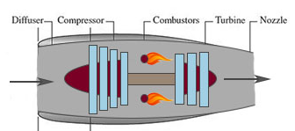
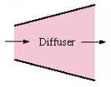
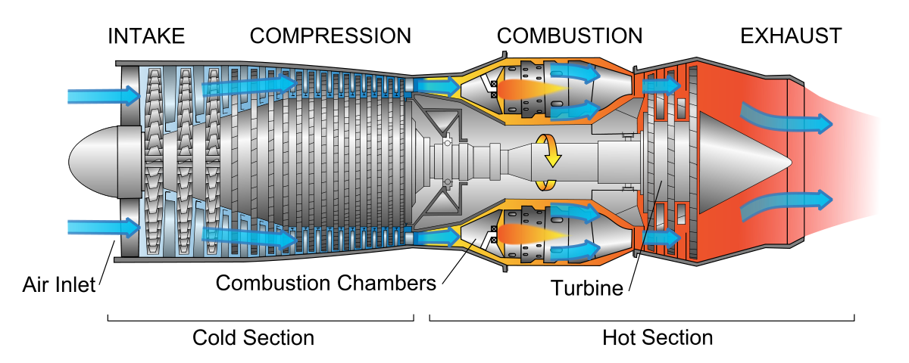
Applications of steady flow energy equation
Nozzles and Diffusers
A nozzle is a device which utilizes a pressure drop to produce an increase in the velocity (kinetic energy) of the fluid.
The action of a diffuser is the reverse of a turbine. It increases the pressure of the fluid at the expense of its velocity

Slide 10
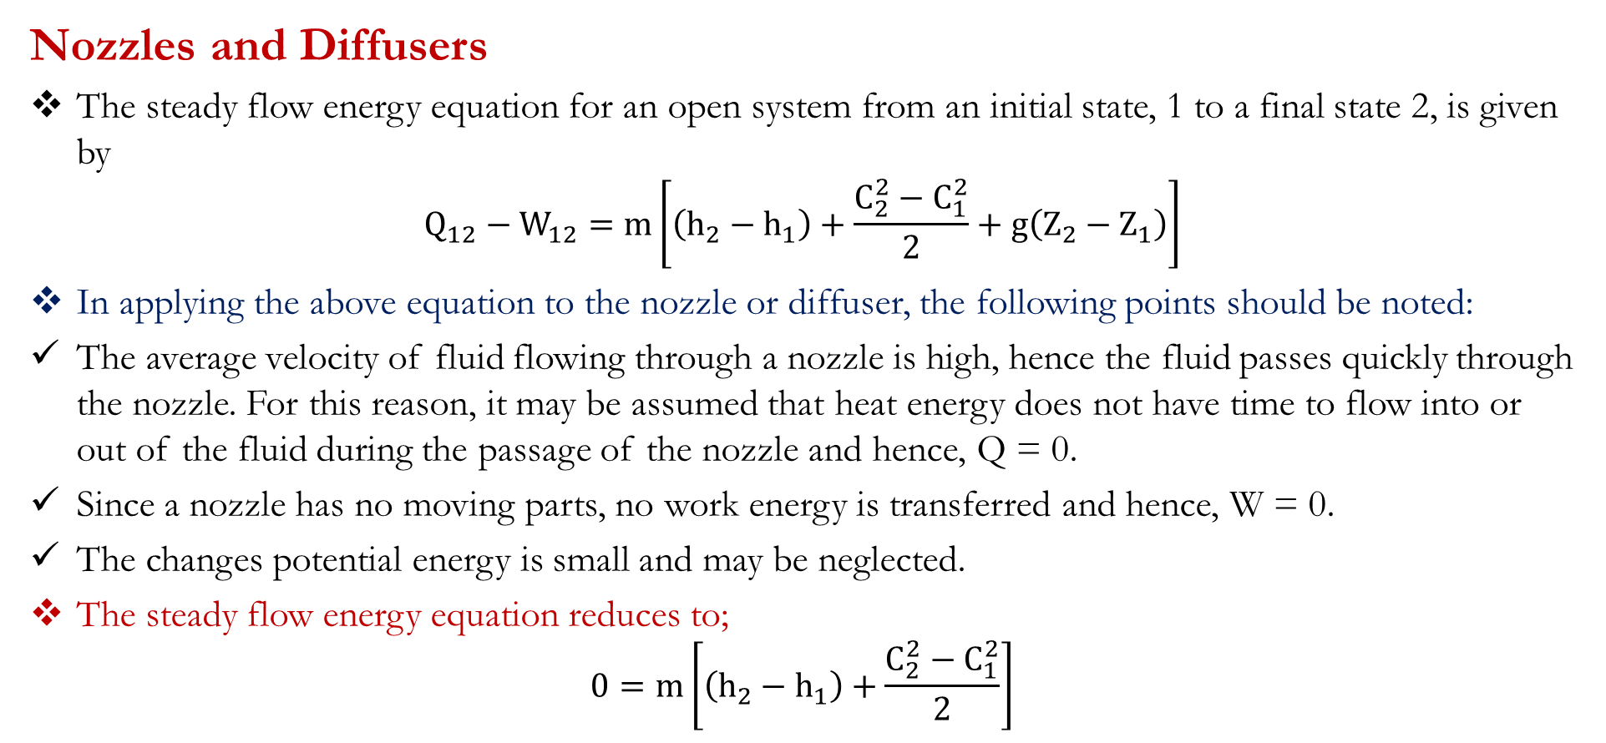
Applications of steady flow energy equation
Nozzles and Diffusers
The steady flow energy equation for an open system from an initial state, 1 to a final state 2, is given by
$$Q_{12}−W_{12}=m\left[\left(h_{2}−h_{1}\right)+\frac{C_{2}^{2}−C_{1}^{2}}{2}+g\left(Z_{2}−Z_{1}\right)\right]$$
In applying the above equation to the nozzle or diffuser, the following points should be noted:
The average velocity of fluid flowing through a nozzle is high, hence the fluid passes quickly through the nozzle. For this reason, it may be assumed that heat energy does not have time to flow into or out of the fluid during the passage of the nozzle and hence, Q = 0.
Since a nozzle has no moving parts, no work energy is transferred and hence, W = 0.
The changes potential energy is small and may be neglected.
The steady flow energy equation reduces to;
$$0=m\left[\left(h_{2}−h_{1}\right)+\frac{C_{2}^{2}−C_{1}^{2}}{2}\right]$$

Slide 11
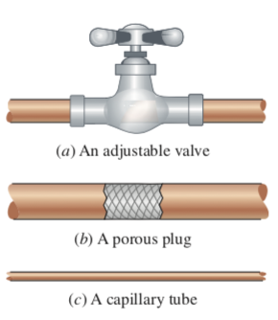
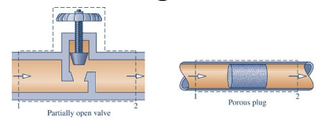
Applications of steady flow energy equation
Throttling Devices
A throttling device is a device that achieves a significant reduction in pressure by introducing a restriction into a line through which a gas or liquid flows.
The means to introduce the restriction include a partially opened valve or a porous plug.

Slide 12
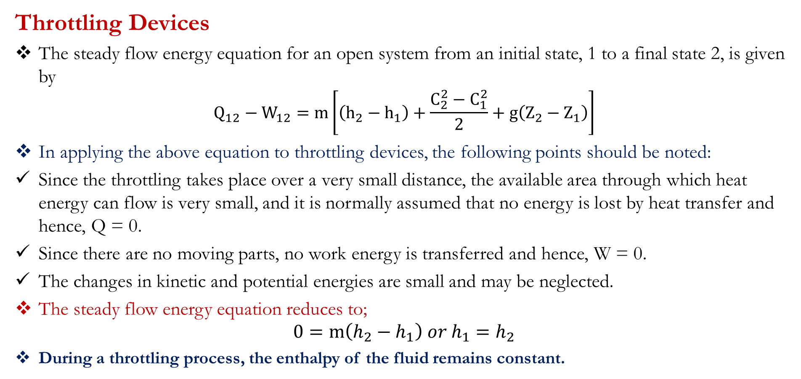
Applications of steady flow energy equation
Throttling Devices
The steady flow energy equation for an open system from an initial state, 1 to a final state 2, is given by
$$Q_{12}−W_{12}=m\left[\left(h_{2}−h_{1}\right)+\frac{C_{2}^{2}−C_{1}^{2}}{2}+g\left(Z_{2}−Z_{1}\right)\right]$$
In applying the above equation to throttling devices, the following points should be noted:
Since the throttling takes place over a very small distance, the available area through which heat energy can flow is very small, and it is normally assumed that no energy is lost by heat transfer and hence, Q = 0.
Since there are no moving parts, no work energy is transferred and hence, W = 0.
The changes in kinetic and potential energies are small and may be neglected.
The steady flow energy equation reduces to;
$$0=m\left(h_{2}−h_{1}\right) or h_{1}=h_{2}$$
During a throttling process, the enthalpy of the fluid remains constant.

Slide 13
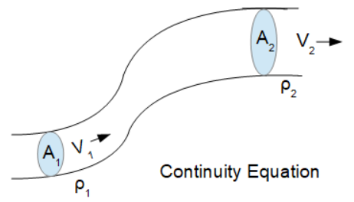
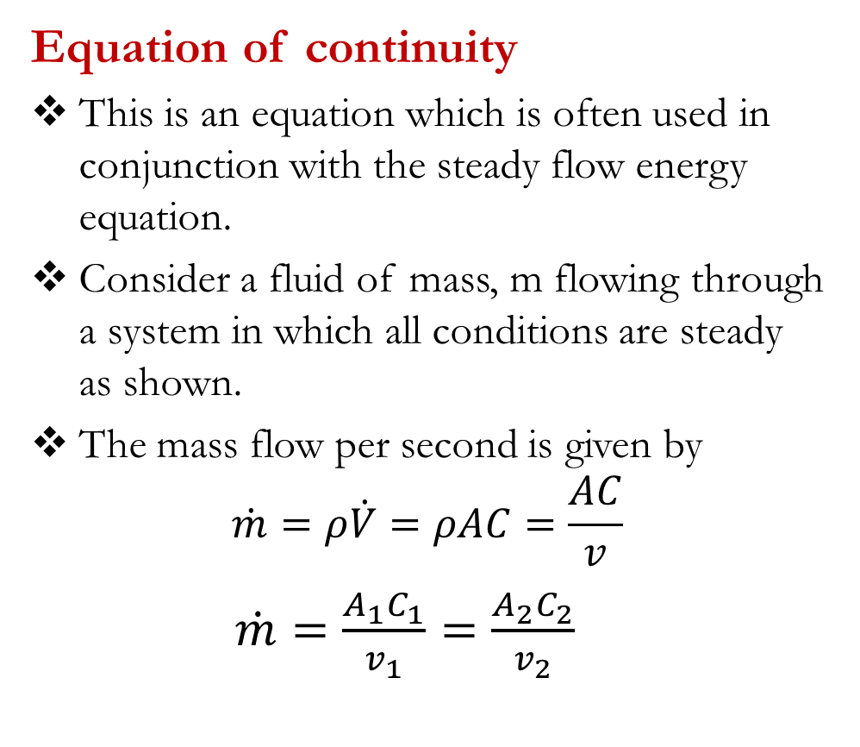
First Law of Thermodynamics: Open system
Equation of continuity
This is an equation which is often used in conjunction with the steady flow energy equation.
Consider a fluid of mass, m flowing through a system in which all conditions are steady as shown.
The mass flow per second is given by
$$\dot{m}=ρ\dot{V}=ρAC=\frac{AC}{v}$$
$\dot{m}=\frac{A_{1}C_{1}}{v_{1}}=\frac{A_{2}C_{2}}{v_{2}}$

Slide 14
First Law for Open Systems: Problems
Problem 1
A boiler operates at a constant pressure of 15 bar, and evaporates fluid at the rate of 1000 kg/h. At entry to the boiler, the fluid has an enthalpy of 165 kJ/kg, and on leaving the boiler, the enthalpy of the fluid is 2200 kJ/kg. the outlet pipe from the boiler is at a height of 16 m above the inlet pipe, and the inlet and outlet velocities of the fluid are 13 m/s and 33 m/s respectively. Determine the rate of heat energy transferred to the boiler.
Suggested answer: [565.3 kW]
Problem 2
A fluid flows through a turbine at the rate of 45 kg/min. Across the turbine, the specific enthalpy drop of the fluid is 580 kJ/kg and the turbine loses 2100 kJ/min in the form of heat energy. Determine the power produced by the turbine, assuming that changes in kinetic energy and potential energy may be neglected.
Suggested answer: [400 kW]

Slide 15
First Law for Open Systems: Problems
Problem 3
A compressor delivers fluid at a rate of 45 kg/min. At the inlet to the compressor, the specific enthalpy of the fluid is 46 kJ/kg, and at outlet from the compressor, the specific enthalpy of the fluid is 175 kJ/kg. If 105 kJ/min of heat energy are lost to the surroundings by the compressor, determine the power required to drive the compressor.
Suggested answer: [98.5 kW]
Problem 4
Fluid with a specific enthalpy of 2800 kJ/kg enters a horizontal nozzle with negligible velocity at a rate of 14 kg/s. At the outlet from the nozzle, the specific enthalpy and specific volume of the fluid are 2250 kJ/kg and 1.25 m³/kg respectively. Assuming adiabatic flow, determine the required outlet area of the nozzle.
Suggested answer: [0.01668 m²]

Slide 16
First Law for Open Systems: Problems
Problem 5
A fluid flowing along a pipe line undergoes a throttling process from 10 bar to 1 bar in passing through a partially open valve. Before throttling, the specific enthalpy of the fluid is 0.3 m³/kg and after throttling is 1.8 m³/kg. determine the change in specific internal energy of the fluid during the throttling process.
Suggested answer: [120 kJ/kg]

Slide 17

KNUST-SESC

